Slide 1

UI Animation
Travis Faas - IUPUI

Slide 2
UI Animation
CSS Animation Introduction
GreenSock Tweens
Principles of animation

Slide 3

CSS Animations

Slide 4
CSS Animations
Specify keyframes (positions at a point in time)
Add the keyframes to a CSS class
Animation plays when the class is added

Slide 5
CSS Animation Properties
Fill mode
Will it pause at the end of the animation, or return to initial look
Duration
How long the animation is in seconds
Reverse
Should the animation play forwards or backwards
And more:
https://developer.mozilla.org/en-US/docs/Web/CSS/animation

Slide 6
Re-triggering CSS animations
Requires extra steps

Slide 7
CSS Animation example
Text box that grows on select
HTML for layout and events
CSS for animation and styles
JavaScript for responding to events, applying animations

Slide 8
HTML
<div class="status">
<textarea id="txtStatInput"
onfocus="textFocus()"
onblur="textLeave()"></textarea>
<button>Submit</button>
</div>

Slide 9
CSS – Base
body {
background: #453d54;
}
.status button {
background-color: #aa80ff;
border-radius: 10px;
color: #fff;
}
.status textarea {
border: 1px solid #999;
border-radius: 10px;
width: 23em;
height: 1em;
}

Slide 10
CSS - Animation
.selected {
animation-name: selectedAnim;
animation-duration: 1s;
animation-fill-mode: forwards;
}
.deselected {
animation-name: selectedAnim;
animation-duration: 1s;
animation-direction: reverse;
animation-fill-mode: forwards;
}
@keyframes selectedAnim {
from { height: 1em; background-color: #fff; }
to { height: 3em; background-color: #ffcfe4 }
}

Slide 11
JS – Event Response, Applying Classes
let txtStatInput = document.getElementById("txtStatInput");
function textFocus() {
resetAnimation(txtStatInput);
txtStatInput.classList.remove("deselected");
txtStatInput.classList.add("selected");
}
function textLeave() {
resetAnimation(txtStatInput);
txtStatInput.classList.remove("selected");
txtStatInput.classList.add("deselected");
}

Slide 12
JS - Reset Animation
function resetAnimation(el) {
el.style.animation = 'none’;
el.offsetHeight; /* trigger reflow */
el.style.animation = null;
}

Slide 13
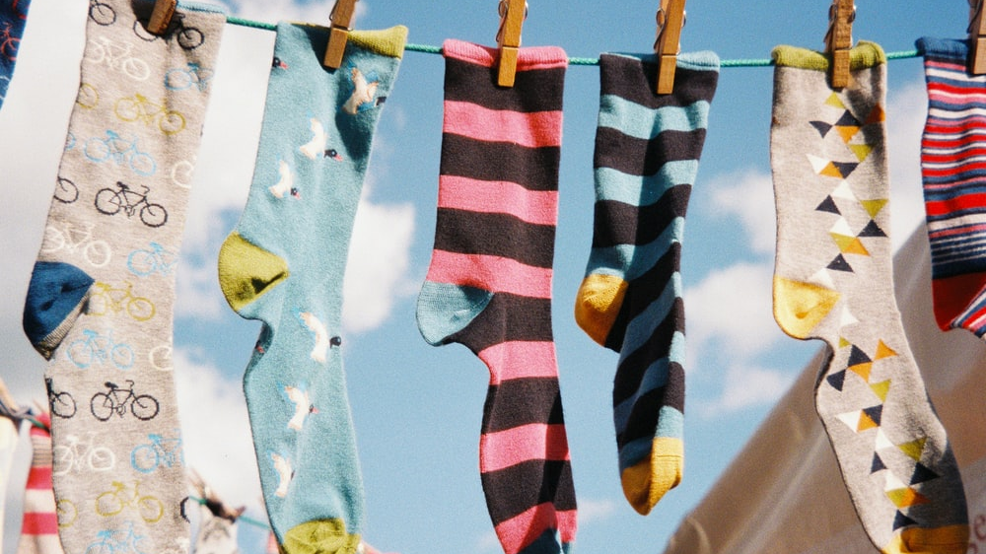
Greensock Tweens

Slide 14
Greensock Tweens
Include the GSAP JS on your HTML
Get a reference to an element
Use TweenLite / TweenMax to specify end properties and time

Slide 15
Getting GSAP
https://greensock.com/
https://cdnjs.cloudflare.com/ajax/libs/gsap/3.5.1/gsap.min.js
Include in the SRC attribute of a script tag

Slide 16
Animating with greensock
TweenMax.to(element, { duration: 2, cssPropA: 3, cssPropB: 2 });
TweenMax.to( txtInput, { duration: .7, width: 400, top: 30 });

Slide 17
A simple transition in
Transitioning in UI elements with a delay

Slide 18
HTML
<ul id="nav">
<li class="navitem">One</li>
<li class="navitem">Two</li>
<li class="navitem">Three</li>
</ul>

Slide 19
JavaScript
var navItems = document.getElementsByClassName("navitem");
init();
function init() {
for(let i = 0; i < navItems.length; i++) {
TweenMax.from(navItems[i],
{ duration: .7, delay: i, alpha: 0, x: -10 }
);
}
}

Slide 20

Principles of Animation

Slide 21
Why Animation?
Animation can make a page feel alive
Movement lets the user know the page is still ticking
Gives a page character

Slide 22
The Principles of Animation
Squash and stretch
Anticipation
Staging
Pose to pose
Follow through and overlapping action
Slow in and slow out
Arcs
Secondary action
Timing
Exaggeration

Slide 23
Squash and Stretch
Not used often, but can add an extra dimension to your UI elements
Very cartoony

Slide 24
Anticipation
It doesn't make sense for a UI element to move around without warning
Making the element 'bounce' a bit in the opposite direction can provide a subtle cue
Too much bounce can also become quite cartoony

Slide 25
Follow through / Overlapping Action
Can be very slick
Don't have everything move at once
Have related elements move with a bit of a delay between each
Like hair, or a chain, or a whip
Don't have them stop dead either
They might overshoot their target and need to settle back
Again, be careful not to be too bouncy

Slide 26
Slow in / Slow Out
Called easing in the tech world
Critically important
Easing is what will give all your transitions 'life’
Subtle effect that pays off

Slide 27
Secondary Action
Often used in the build in process of a web page
Have multiple elements all moving at the same time, emphasizing that the page is loading

Slide 28
Timing
Used in UIs less to create a sense of weight, more to create a sense of mood
Less time = faster = more energetic, high importance
More time = slower = Mellow, refined, less jarring for the user

Slide 29
Communication / Location
Users of your applications / pages will always be navigating your page's 'space’
Just like real life where we navigate cities, rooms, hallways
In real life we can get a 'sense' of where we are by what moves where as we walk about
We can communicate similar ideas by how items move about our page during usage
Xbox UI Video

Slide 30
Good foundational article
https://material.io/design/introduction

